Slide 1


IT8611 Mini Project
M.A.M. COLLEGE OF ENGINEERING AND TECHNOLOGY
Siruganur, Tiruchirappalli – 621 105.
Project Title:Improved Fraud Detection in e-Commerce Transactions
Register Number | Name
812020205017 | Elamaran.D
812020205033 | Naveenprasath.R
812020205040 | Sancheevi.R
812020205307 | Lokchandar.AR
Under the esteemed guidance of
Supervisor Name:Ms.P.Suganya
Designation: Assistant Professor
Version: MAMCET_PR-1.1
Notes:
Notes for Teachers:
The Synopsis presentation should contain 1. Real life applications 2. Overview of the subject 3. PO’s CO’s of the course 4. Individual Units overview 5. Lesson Plan 6. Flip Class topics
“ Be professionally dressed and use a QUALITY PEN. Never hand an ordinary PEN as a Cosmetic Effect”

Slide 2
Project Title
Improved Fraud Detection in e-Commerce Transactions

Slide 3
Content in this Presentation
Sl. No7 | Details | Slide Number
1. | Abstract | 5
2. | Introduction | 6
3 | Inference drawn/Existing system | 7
4. | Proposed solution | 8
5. | Block Diagram/Architecture | 9
6. | Modules | 10
7. | Conclusion | 17
8. | Screenshots | 19
9. | Bibliography | 21

Slide 4
Problem Statement
To predict the Fake Review Using Sentimental analysis

Slide 5
Abstract
Sentiment analysis is defined as the process of mining of data ,view, review or sentence to predict the emotion of the sentence through natural language processing(NLP).The sentiment analysis involve classification of text into three phase”Positive”,”Negative”or” Neutral”.It analyzes the data and labels the ‘better’ and ‘worse’ sentiment as positive and negative respectively. Amazon,Flipkart etc. user share their views ,feelings in a continent way. This states that there is need to find the better solution to get much better results than the previous approach or technique used to find polarity of sentence. E-commerce transactions involve numerous parties, including buyers, sellers, and payment service providers, which creates opportunities for fraudulent activities such as identity theft, stolen credit card usage, and unauthorized transactions. Traditional rule-based fraud detection systems often fall short in accurately detecting sophisticated fraud patterns, leading to increased financial losses and compromised user experiences.

Slide 6
Introduction
These growing raw data are an extremely high source of information for any kind of decision making process either positive or negative.
To analysis of such huge data automatically, the field of sentiment analysis has turn up. The main aim of sentiment analysis is to identifying polarity of the data in the Web and classifying them.
Sentiment analysis is text based analysis, but there are certain challenges to find the accurate polarity of the sentence.This states that there is need to find the better solution to get much better results than the previous approach or technique used to find polarity of sentence.
In WWW,Where millions of people express their views in their daily interaction,either in the social media or in e-commerce which can be their sentiments and opinions about particular thing.

Slide 7
Inferences drawn / Existing System
As most of the people require review about a product before spending their money on the product.
So people come across various reviews in the website but these reviews are genuine or fake is not identified by the user.
In some reviews websites some good revies are added by the product company people itself in order to make in order to produce false positive product reviews.
They give good reviews for many different products manufactured by their own firm.
User will not be able to find out whether the review is genuine or fake.
The user are not identified to the product is a duplicate or not.

Slide 8
Proposed Solution
Now a day’s all users are using to the online product purchase but the users are not to find out the product review is a fake or genuine.
The proposed system of this “Fake Product Review Monitoring or Removal for Genuine Online Product Reviews” using NLP system is introduced.
This system will find out fake reviews made by posting fake comments about a product by identifying the Mac address along with review posting patterns. User will login to the system using his user id and password and will view various products and will give review about the product.

Slide 9
Block Diagram Architecture
Training Phase
Prediction Phase
Data Accusation
User Interface
Preprocessing
Pre processing
Clustering
Feature Selection
Feature Selection
Trained database
Naïve Bayesian
Predict Spam or fake review and Deduplication
Mini Project - M.A.M. College of Engineering and Technology, Siruganur, Tiruchirappalli – 621 105.

Slide 10
LIST OF MODULES
Admin
User
Preprocessing
Spam Detection
Deduplication
Mini Project - M.A.M. College of Engineering and Technology, Siruganur, Tiruchirappalli – 621 105.

Slide 11
Admin
Gathering the datasets, emails from different dataset available.
Data preprocessing, before text classification we are creating bag of words model and applying count vectorizer to hash the words. Using Naïve-Bayes algorithm, we classify whether the texts are spam or non-spam.
We extract links present in E-mails and apply Link Analysis which comprises of 2 steps:
Extract the contents of web pages or check if any form is present and whether it asks for personal information.
Virus Total API is used to check for presence of phishing links.
Mini Project - M.A.M. College of Engineering and Technology, Siruganur, Tiruchirappalli – 621 105.

Slide 12
User
Login
This module has authenticated the user’s username and password is correct or not. If it is correct user can access their account. Otherwise the system has produced the invalid user name and password.
Sending E-Mail
This email will be sent to the receiver of the mail as send automatically into the message form tanning data set. As the message hits the inbox of the recipient email address, the data extraction will be done. The e-mail address will be Located in the database.
Receiving the E-Mail
E-mail messages are sent through the data set server which resides on the mail server. The messages are filtered to spam and non-spam mail.

Slide 13
Preprocessing
Today, most of the data in the real world are incomplete containing aggregate, noisy and missing values.
Pre-processing of e-mails in next step of training filter, some words like conjunction words, articles are removed from email body because those words are not useful in classification.
As mentioned earlier, we are using WEKA tool to facilitate the experiments. For both experiments, the datasets are presented in Attribute-Relation File Format(ARFF).

Slide 14
Spam Detection
The Na¨ıve Bayes algorithm is a simple probabilistic classifier that calculates a set of probabilities by counting the frequency and combination of values in a given dataset.
In this research, Na¨ıve Bayes classifier the words features to identify spam e-mail and a text is representing as the bag of its word.
Na¨ıve Bayes technique used Bayes theorem to determine that probabilities spam e-mail.
Then, when we saw a message containing this word, we could tell for sure that were spam email. Bayesian spam filters have learned a very high spam probability for the words.
So, to calculate the probability that e-mail is spam or non-spam Na¨ıve Bayes technique used Bayes theorem

Slide 15
Deduplication
Deduplication is a technology that can be used to reduce the amount of storage required for a set of files by identifying duplicate “chunks” of data in a set of files and storing only one copy of each chunk.
Subsequent requests to store a chunk that already exists in the chunk store are done by simply recording the identity of the chunk in the file’s block list; by not storing the chunk a Inbox, the system stores less data, thus reducing cost.

Slide 16
Conclusion
We found that the Naïve Bayesian algorithm outperformed the other classifiers.
This simple algorithm achieved great performance and was easy to implement.
Believe the performance of this algorithm could still be improved.
Spam mails area unit used for spreading virus or malicious code, for fraud in banking, for phishing, and for advertising.
In this project, we implemented the system to analyze each and every mail. And also provide privacy based detection system to encode the emails using Digest based system

Slide 17
Future Enhancement
Unwanted E-mails.
A spam email can also be used to obtain personal data.
Example: social security number or user IDs and passwords, which then can be used for identity theft and various other crimes.
Spam email can be designed to solicit credit card numbers or bank account information, which can be used for credit card fraud or money laundering.

Slide 18
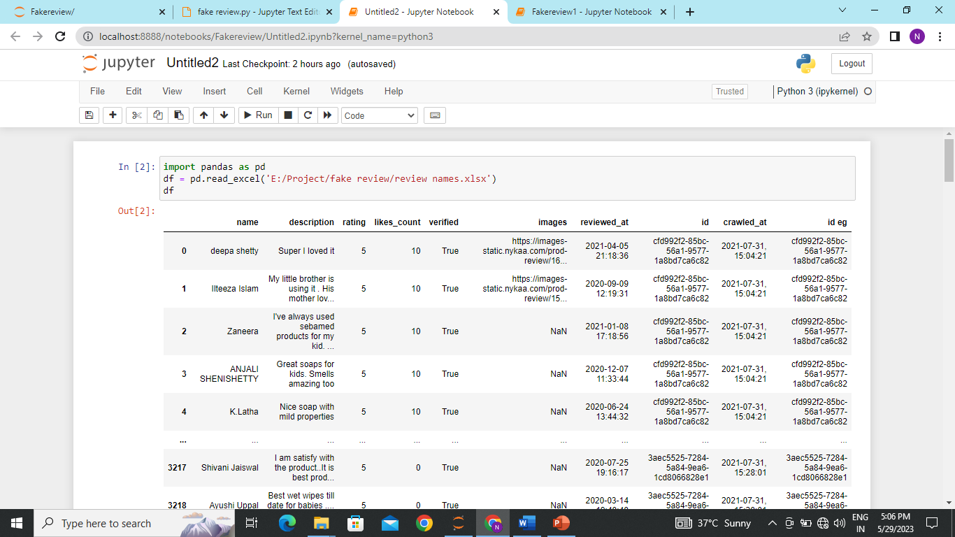
Screenshots

Slide 19
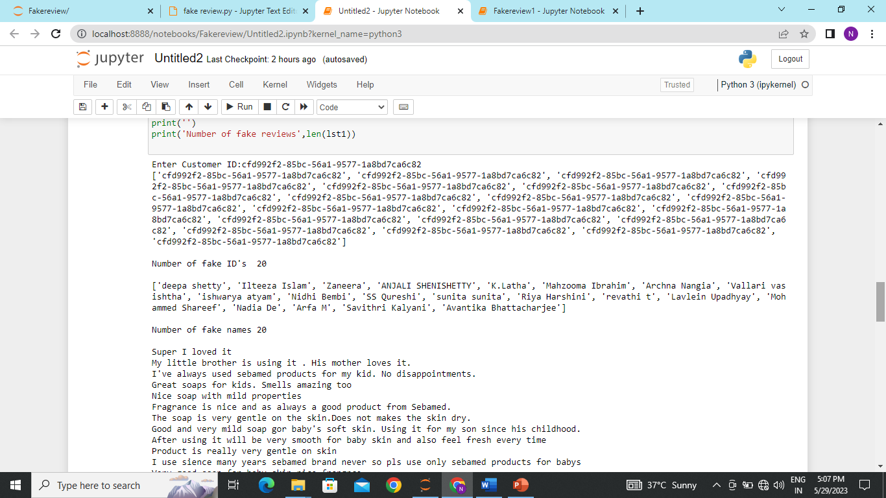
Screenshots

Slide 20
Bibliography
Srinivasan, S., Kumar, A., & Sankar, C. (2016). Fraud detection in e-commerce transactions using machine learning techniques. Procedia Computer Science, 89, 110-117.
Fumera, G., Roli, F., & Anagnostopoulos, I. (2019). A review of recent advances in automated credit card fraud detection. Neural Computing and Applications, 31(10), 6717-6740.
Dal Pozzolo, A., Caelen, O., Le Borgne, Y. A., Waterschoot, S., Bontempi, G. (2015). Learned lessons in credit card fraud detection from a practitioner perspective. Expert Systems with Applications, 42(10), 5008-5020.
Huang, Y. H., Chen, H. J., & Lin, Y. C. (2017). A hybrid credit card fraud detection model using neural networks and multivariate analysis. Expert Systems with Applications, 82, 113-123.

Slide 21

Thank You

